Slide 2
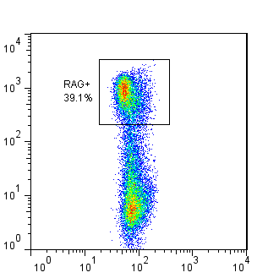
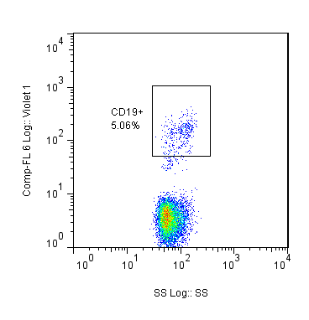
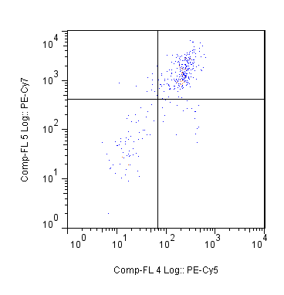
Thymus
RAG+
39.1%
CD19+
5.06%
CD8
RAG
CD19
Side Scatter
Side Scatter
CD4
Notes:
Thymus 1 20150722 24.10.14

Slide 3
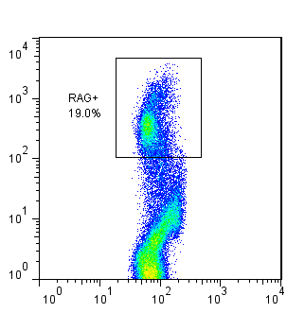
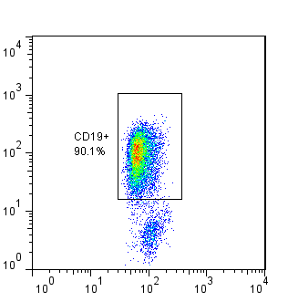
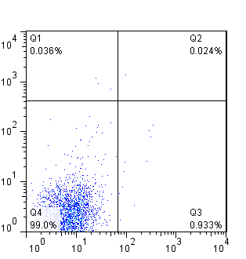
Bone Marrow
RAG
CD19
CD8
Side Scatter
Side Scatter
CD4
Notes:
Bone marrow

Slide 4
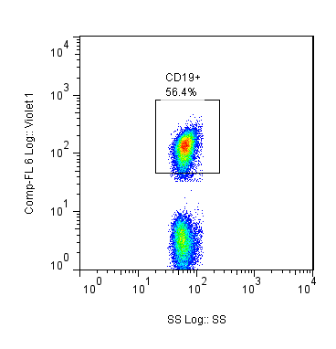
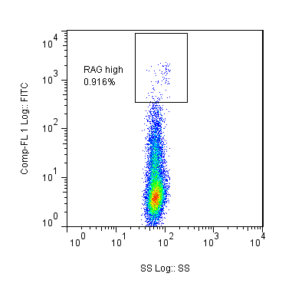
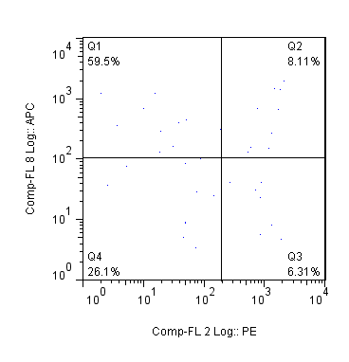
Thymus
+
80.5%
CD19
RAG
IgM
Side Scatter
Side Scatter
TcRβ
Notes:
Thymus

Slide 5
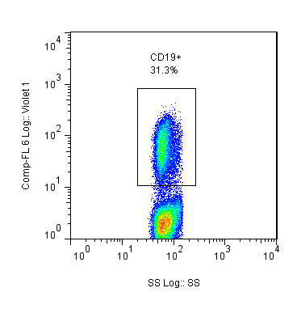
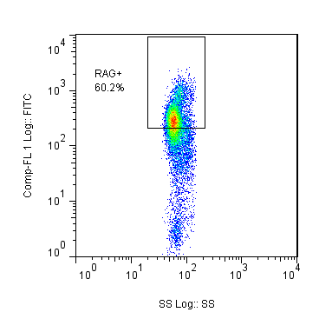
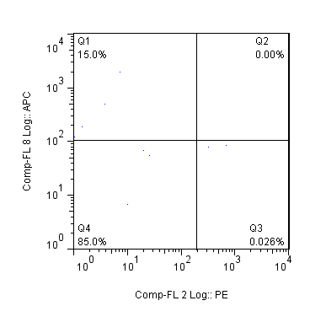
Bone Marrow
CD19
RAG
IgM
Side Scatter
Side Scatter
TcRβ
Notes:
Bone marrow

Slide 6
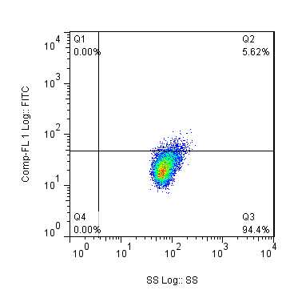
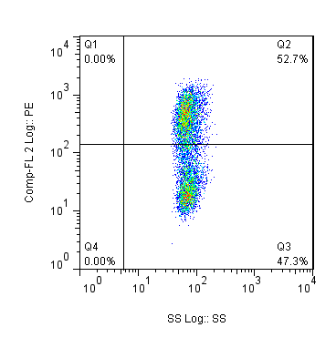
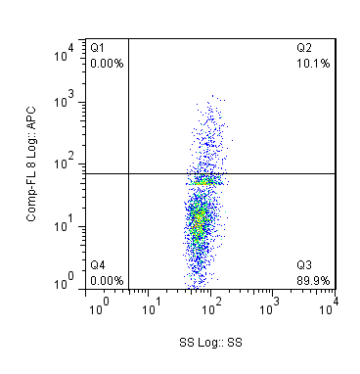
IgM
CD43
CD19
Side Scatter
Side Scatter
TcRβ
Notes:
NOD (Mouse 11 20th July)

Slide 7
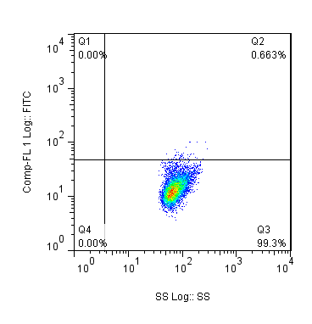
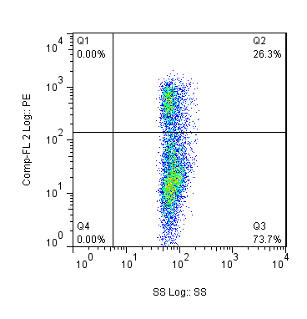
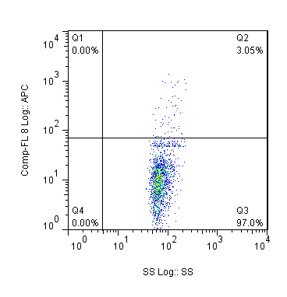
IgM
CD43
CD19
Side Scatter
Side Scatter
TcRβ
Notes:
B6

Slide 8
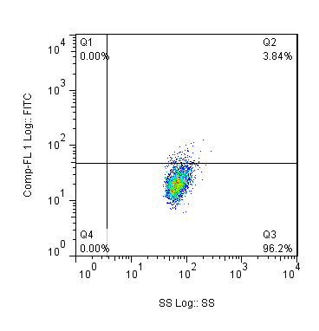
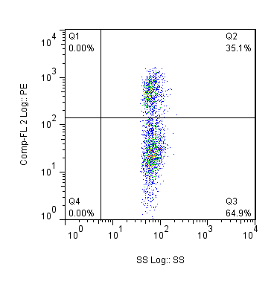
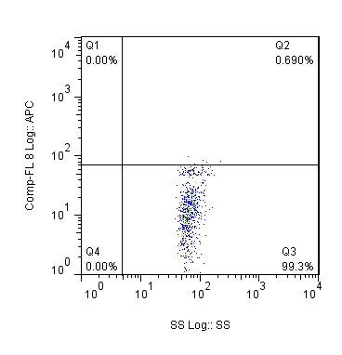
IgM
CD43
CD19
Side Scatter
Side Scatter
TcRβ

Slide 9
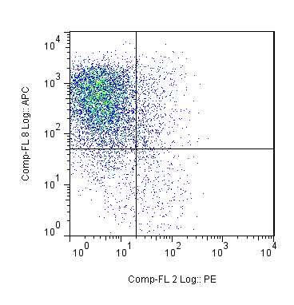
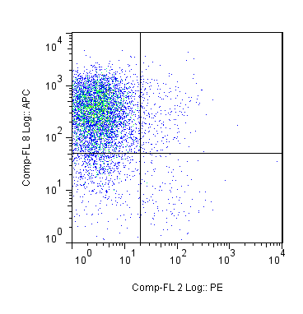
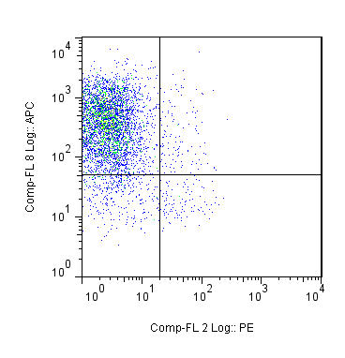
4 weeks
7 weeks
11 weeks
IgM
IgM
IgM
Pre
Pro
Pre
Pro
Pre
Pro
CD43
CD43
CD43
Notes:
Thy 1 24.10.14, Thy 3 31.10.14, Thy 12 10.7.15
NOD Pro pre presence

Slide 10
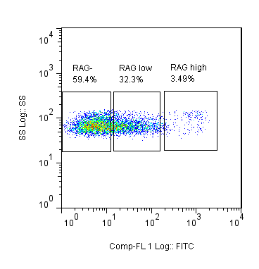
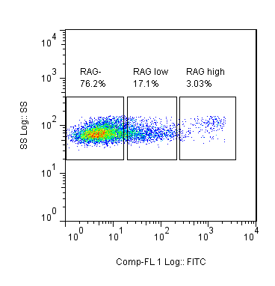
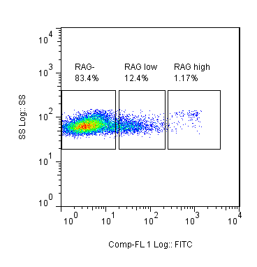
4 weeks
7 weeks
11 weeks
GFP-
59.4%
GFP^{low}
32.3%
GFP^{high}
3.49%
GFP-
76.2%
GFP^{low}
17.1%
GFP^{high}
3.03%
GFP-
83.4%
GFP^{low}
12.4%
GFP^{high}
1.17%
Side Scatter
Side Scatter
Side Scatter
GFP
GFP
GFP
Notes:
Thy 1 24.10.14, Thy 1 31.10.14 & Thy 5 24.11.14

Slide 11
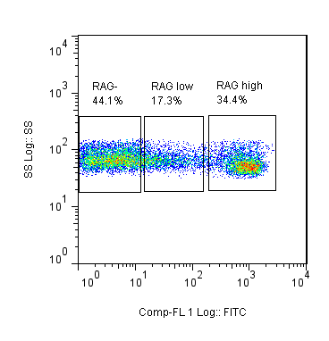
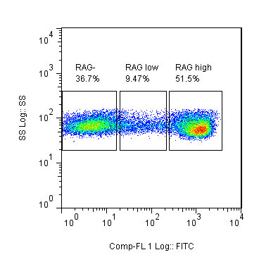
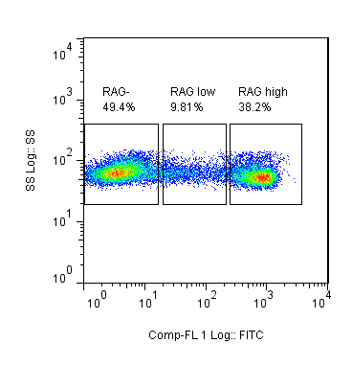
4 weeks
7 weeks
11 weeks
GFP-
44.1%
GFP^{low}
17.3%
GFP^{high}
34.4%
GFP-
36.7%
GFP^{low}
9.47%
GFP^{high}
51.5%
GFP-
49.4%
GFP^{low}
9.81%
GFP^{high}
38.2%
Side Scatter
Side Scatter
Side Scatter
GFP
GFP
GFP
Notes:
Thy 1 24.10.14, Thy 1 31.10.14, Thy 5 24.11.14
Total thymus

Slide 12
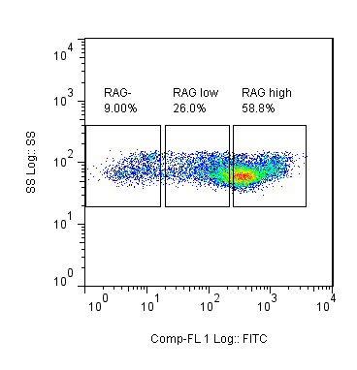
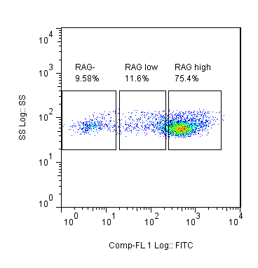
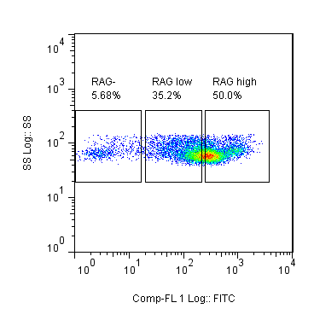
4 weeks
7 weeks
11 weeks
GFP-
9.00%
GFP^{low}
26.0%
GFP^{high}
58.8%
GFP-
9.58%
GFP^{low}
11.6%
GFP^{high}
75.4%
GFP-
5.68%
GFP^{low}
35.2%
GFP^{high}
50.0%
Side Scatter
Side Scatter
Side Scatter
GFP
GFP
GFP
Notes:
BM

Slide 13
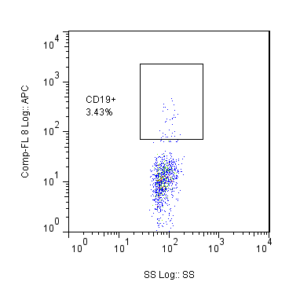
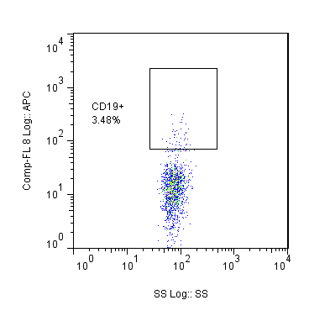
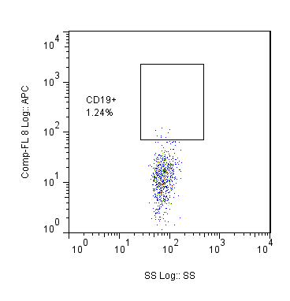
B6
NOD WT
NOD KO
CD19+
3.43%
CD19+
3.48%
CD19+
1.24%
CD19
CD19
CD19
Side Scatter
Side Scatter
Side Scatter
Notes:
Mature B cell increases pro B cells
B6 (2), NOD (8), KO (5)

Slide 14
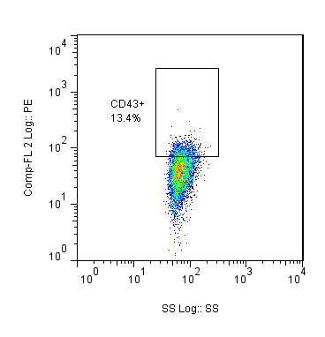
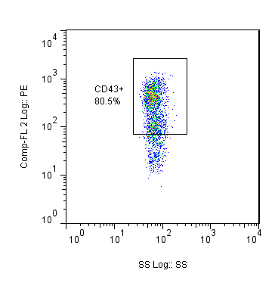
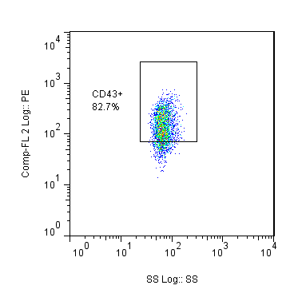
B6
NOD WT
NOD KO
CD43+
13.4%
CD43+
80.5%
CD43+
82.7%
CD43
CD43
CD43
Side Scatter
Side Scatter
Side Scatter

Slide 15

72.0%
RAG+
39.1%
CD19+
5.06%
RAG
CD19
CD8
Side Scatter
Side Scatter
CD4
Notes:
Thymus 1 20150722 24.10.14

Slide 16


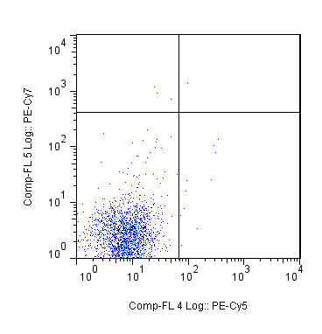
0.024%
RAG+
19.0%
CD19+
90.1%
RAG
CD19
CD8
Side Scatter
Side Scatter
CD4
Notes:
BM 1 20150722 24.10.14

Slide 17
Fraction | Number of Cells | % B220+ | % GFP+ of B220+ | Number B220+ | Number of B220+ GFP+ | % B220+ IgM+ | % GFP+ of B220+ IgM+ | Number B220+IgM+ | Number of B220+ IgM+ GFP+
CD19+ | 1.01 x 10⁷ | 5.42 | 24.3 | 434686 | 105629 | 4.78 | 24.6 | 383358 | 94306
CD19- | 2.59 x 10⁷ | 0.161 | 33 | 34219 | 11292 | 0.002 | 0 | 425 | 0
Notes:
GFP → WT

Slide 18
Fraction | Number of Cells | % B220+ | % B220+ IgM+ | Number B220+ | Number B220+IgM+
CD19+ | 1.3 x 10⁵ | 2.86 | 2.37 | 2743 | 2273
CD19- | 3.67 x 10⁷ | 0.151 | 0.005 | 42920 | 1421
Notes:
NOD → KO

Slide 19
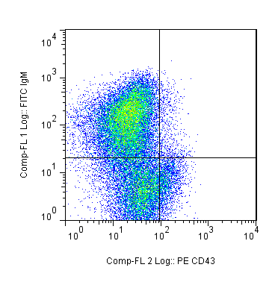
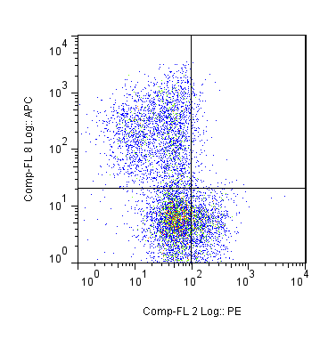
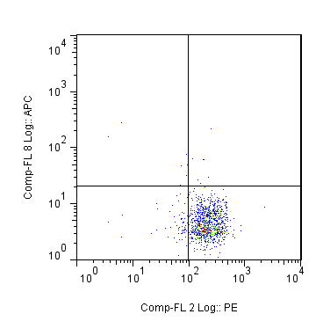
B6
NOD WT
NOD KO
IgM
IgM
IgM
CD43
CD43
CD43

Slide 20
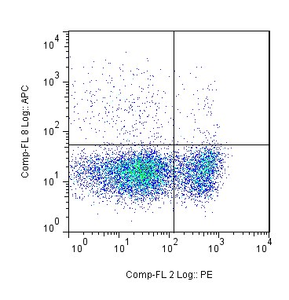
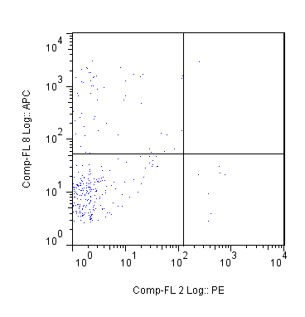
0.670%
0.009%

